Slide 1

School of Computer Science & IT
Programme: BCA
RESEARCH METHODOLOGY(22BCA5RM01)
MODULE 1: Introduction to Research

Slide 2
Session -4
What is a Research Problem
Selecting the Research problem

Slide 3

Research Problem

Slide 4
Research Problem
Generally speaking a research problem is a situation that needs a solution and for which there are possible solutions or a question that researcher wants to answer
Identification & formulation of a research problem is the first step of the research process.
Selection of research problem depends on several factors such as researcher’s knowledge, skills, interest, expertise, motivation &creativity with respect to the subject of inquiry.
It is believed that most of the good research studies need lots of time for selection of a research problem.

Slide 5
Characteristics of a Good Research Problem
Stakeholders will potentially benefit from the knowledge derived from this study
Results will be applicable
Results will be theoretically relevant
Findings will lend support to untested theoretical assumptions, extend or challenge an existing theory, or clarify a conflict in the literature
Findings will potentially formulate or alter practice or policies

Slide 6
SOURCES OF RESEARCH PROBLEM
Personal experiences
▪Literature sources
▪Existing theories
▪Previous research
▪Academic experiences

Slide 7
SOURCES OF RESEARCH PROBLEM
Brain storming
▪Intuition
▪Consultations
▪Social issues
▪Professional experience

Slide 8
Steps in identifying a research problem
1. Outline areas of interest
Read about your interests
Observe your environment
Be curious
2. Choose a topic
Talk to your
Colleagues
Find out what others are doing
Ask questions
3. Narrow your topic
4. Identify a research problem
5. Identify the purpose for your study

Slide 9
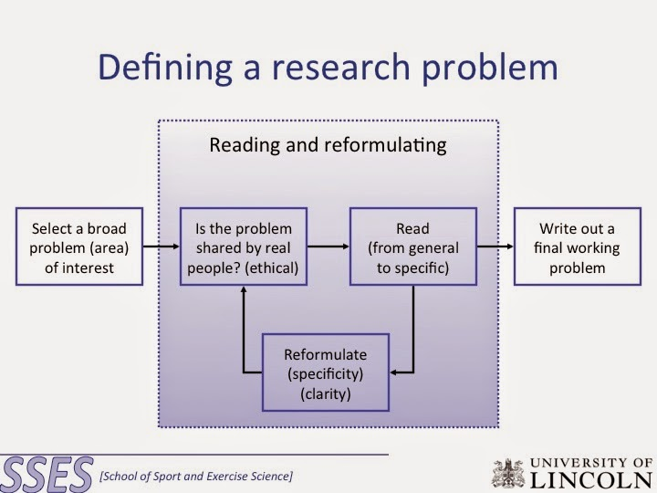

Slide 10
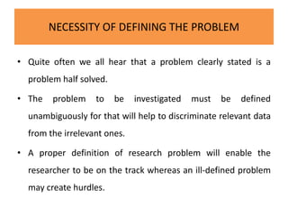

Slide 11
Selecting the problem and defining its significance
Research Problem No.1
Problem Statement: "Developing an efficient algorithm for real-time image recognition on low-power mobile devices."
Identify the Research Area: Determine the broad area of computer science your research falls into, such as algorithms, artificial intelligence, mobile computing, etc.
Example: "This research falls under the area of algorithm design and mobile computing."
Review Existing Literature: Conduct a literature review to understand what research has already been done related to your topic.
Identify gaps or limitations in current solutions that your research can address.
Example: "Existing image recognition algorithms often require significant computational resources, which limits their applicability on mobile devices."

Slide 12
Selecting the problem and defining its significance
Formulate a Specific Problem Statement: Clearly define the problem you aim to solve or the question you aim to answer.
Example: "The specific problem is to develop an algorithm that can perform real-time image recognition with high accuracy on low-power mobile devices."
4. Justify the Importance of the Problem: Explain why solving this problem is important or relevant in the field of computer science.
Example: "Efficient image recognition on mobile devices can enable new applications in areas like augmented reality, mobile health, and smart environments."
5. State Objectives or Hypotheses: Outline what you aim to achieve or prove through your research.
Example: "The objective is to design an algorithm that achieves a balance between accuracy and computational efficiency, suitable for deployment on mobile platforms."
6. Consider Constraints and Feasibility: Assess any constraints or limitations that may impact your research, such as time, resources, or technological constraints.
Example: "The algorithm should be implementable within the computational and memory limits typical of current mobile devices."

Slide 13
Selecting the problem and defining its significance
7Define Scope and Boundaries: Clearly define what is included and what is excluded from your research.
Example: "This research focuses on developing the algorithm and evaluating its performance on specific mobile hardware; it does not include hardware design or extensive user interface considerations."
8. Formulate Research Questions: Break down the main problem into specific research questions that your study will address.
Example: "What are the key design principles for optimizing image recognition algorithms on mobile devices? How does the proposed algorithm compare with existing solutions in terms of accuracy and efficiency?"
Reflect on any ethical considerations or potential societal impacts of your research.
Example: "Ensure that the algorithm respects user privacy and operates within legal frameworks regarding data usage."
After defining the problem, review your statement for clarity and completeness.
Refine as necessary based on feedback from peers or advisors
Consider Ethical and Societal Implications (if applicable):
Review and Refine:

Slide 14
Research Problem No. 2
Problem Statement: "Improving the security of Internet of Things (IoT) devices against cyber attacks."
Step-by-blem Statement:
Identify the Broad Area of Interest: Determine the specific field or domain within computer science that your research will address.
Example: "This research falls within the domain of cybersecurity and IoT."
Review Existing Literature: Conduct a literature review to understand the current state of research in cybersecurity for IoT devices.
Identify gaps, challenges, or issues that have not been fully addressed.
Example: "Existing literature indicates that IoT devices are vulnerable to various cyber attacks due to their limited computing resources and lack of robust security measures."
Formulate a Specific Problem Statement: Clearly define the specific problem or issue you aim to investigate or solve.
Example: "The specific problem is to develop improved security mechanisms that can effectively protect IoT devices from cyber attacks, considering their resource-constrained nature."

Slide 15
Justify the Importance of the Problem: Explain why solving this problem is important or relevant in the context of computer science and society.
Example: "Securing IoT devices is crucial as their widespread adoption continues, and they are increasingly integrated into critical infrastructure, homes, and industrial systems."
5. State Objectives or Hypotheses: Outline the objectives of your research or the hypotheses you aim to test.
Example: "The objective is to design and evaluate lightweight cryptographic protocols that can be efficiently implemented on IoT devices without compromising security."
Consider Constraints and Feasibility: Assess any limitations or constraints that may impact your research, such as technological, financial, or ethical considerations.
Example: "The research will focus on cryptographic solutions that are computationally feasible for IoT devices with limited processing power and memory."
Define Scope and Boundaries: Clearly define what aspects are included and excluded from your research.
Example: "This research focuses on the development and evaluation of cryptographic protocols tailored for IoT devices; it does not address physical security aspects or broader network security issues."

Slide 16
Formulate Research Questions: Break down the main problem into specific research questions that your study will address.
Example: "What are the key requirements for cryptographic protocols suitable for IoT devices? How do the proposed protocols compare with existing solutions in terms of security and efficiency?"
9. Consider Ethical and Societal Implications (if applicable): Reflect on any ethical considerations or potential societal impacts of your research.
Example: "Ensure that the proposed security mechanisms respect user privacy and comply with regulatory standards regarding data protection."
10. Review and Refine: After defining the problem statement, review it for clarity, specificity, and relevance.
Refine as necessary based on feedback from peers, advisors, or stakeholders.

Slide 17
conclusion
Conclusion:
Defining a research problem in computer science involves systematically identifying an area of interest, reviewing existing knowledge, formulating a specific problem statement, and ensuring clarity on objectives, constraints, and ethical considerations. Each step helps in framing a focused and impactful research study.

